Slide 1

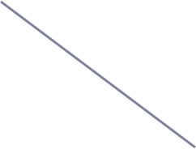


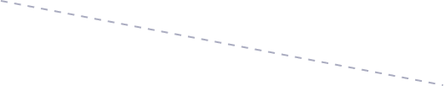
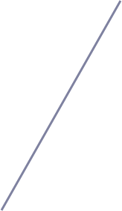
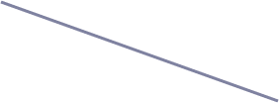
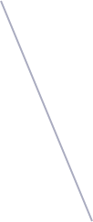
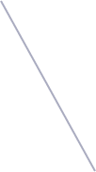
ASTROPHYSICS & DATA
Vector Databases & Milvus
Similarity search for the boom alert broker
Sneha Maharjan
School of Physics and Astronomy · University of Minnesota

Slide 2

The query we can’t ask today
Vectors help answer "find things like this one, when I can't state why."
✓
What MongoDB does well
?
What it can’t express
Exact and range predicates over scalar fields, backed by B-tree indexes.
There is no column to sort by, and no threshold to filter on.
find alerts where
magpsf < 18.5
and jd > 2460800
and within 5" of (ra, dec)
“Show me the 50 alerts
that look most like
this one.”
Answerable in milliseconds.
This is the entire motivation for the rest of the talk.
Filtering needs you to know the field values in advance. Similarity search lets the example object itself be the query.
If a property is a clean computable number, you filter on it. If it's a fuzzy pattern that resists being written as a single value, that's what the vector is for.
Notes:
The embedding doesn't contain the field values. It's not a package of magnitude, position, and Julian date bundled together.
An embedding is a list of numbers, say five hundred and twelve floats, that a model produces from some input, like an image cutout or a light curve.
Those numbers place the object somewhere in an abstract, learned space. They capture the shape or the pattern the model was trained to notice, not the catalogue values themselves.
So, the similarity search finds neighbors that are close in that learned space, meaning they look alike to the model. It does not extract or reason over your scalar fields.
You get an object with no classification, no idea whether it's a type one, type two, or something odd. You cannot filter your way to its relatives because you don't know what makes it what it is. But you can drop the whole object into vector search and ask for its nearest neighbors. If they come back as confirmed type ones, you've just learned something about your unknown, without ever naming a single field. That's discovery, not lookup. So the honest one-liner for the room is: filtering answers "find things matching criteria I can state." Vectors answer "find things like this one, when I can't state why." Astronomy is full of the second kind, and that's the gap Mongo can't fill.

Slide 3

Why Astrophysics Needs Vector Search
Astronomical survey stream processing at massive scale require new query paradigms.
1
The Alert Explosion
2
Beyond Scalar Filtering
3
Instant Anomaly Detection
Modern telescopes (e.g. Rubin Observatory) generate millions of alerts per night.
Traditional database queries cannot keep up with real-time classification demands across vast multi-dimensional feature spaces.
Complex transients (supernovae, AGN flares, variable stars) cannot be defined by simple numerical range filters.
Embedding vectors represent raw light curves and image cutouts holistically in feature space.
Milvus identifies nearest neighbors in sub-second timelines.
Enables instant discovery of rare physical phenomena and historical analogue matching during rapid follow-up windows.
Key Takeaway: Vector similarity search replaces rigid SQL predicates with continuous similarity semantics. It turns astronomical query generation from "match these explicit criteria" to "find me previous events that behave like this new discovery."

Slide 4
Vectors come from embedding models
1
2
3
4
Raw input
Model
Embedding
Milvus
Image cutouts, light curve,
or alert packet with metadata
CNN, autoencoder, or the
penultimate layer of a classifier
384 floats that place the object
somewhere in a learned space
Stores the vector, builds an
index, answers "what’s nearby"
The database does not create meaning. Two alerts are "similar" only in the sense the embedding model was trained to capture. A bad model gives you fast, confident, useless neighbours.
Notes:
Stress: choosing/validating the embedding model is a science problem and it is upstream of every database decision here.

Slide 5

Retrieval-Augmented Generation (RAG) Flow
How vector databases and similarity search power ground-truth AI responses
1
Knowledge Ingestion
2
Similarity Search Engine
3
LLM Synthesis
Raw Documents
PDFs, Articles, Scientific Papers & Logs
User Query Input
"Find transients like event #4029"
Context Injection
Top matched passages added to prompt
ANN Vector Search
Calculates Top-K Nearest Neighbors using metric:
• Cosine / L2 / IP
• Sub-second latency
• Semantic retrieval
Chunking & Model
Passages converted to 512d dense vectors
Query Embedding
Converted using same embedding model
Grounded Response
LLM synthesizes response backed strictly by relevant vector database context.
Vector DB Storage
Indexed in Milvus
Key Takeaway: Vector Similarity Search acts as the bridge between static enterprise data and dynamic LLM reasoning. By replacing keyword matching with continuous semantic retrieval, RAG avoids hallucinations and delivers precise, context-aware answers in real-time.
Notes:
Similarity search doesn’t look for matching words, it looks for matching meaning. So if you ask about kilonovae, it can find a chunk about neutron star merger afterglows even if the word ‘kilonova’ never appears, because the embedding model has learned those ideas are related. That’s the big difference from a keyword search.

Slide 6
Metrics to determine closeness
Cosine for direction only, inner product when length carries signal, L2 for absolute distance.
Metric is needed at index time, not only at search time.
L2 / Euclidean
Inner Product
Cosine
Straight-line distance.
Sensitive to magnitude as well
as direction.
Closeness in abs. position matters
Dot product. Rewards vectors
that are both aligned and large.
Both direction and magnitude carry meaning
Angle only, magnitude ignored.
Equals IP on normalised vectors.
ONLY direction matters
Smaller = more similar
Larger = more similar
Larger = more similar
One rule to remember: match the metric to the loss the model was trained with.
Query a cosine-trained model with L2 and your results will be quietly, plausibly wrong — no error, just worse neighbours.
The embedding captures whatever the model was trained to notice.
Notes:
"Quietly wrong" is the theme to plant here — it comes back in the evaluation slide.
Vector direction and magnitude representation-
cosine- only care about direction (the model saw the same kind of thing)
Magnitude – carries no reliable signal
First line: The model's training objective defines what its vectors mean.
Second line: Direction encodes what the model saw. Magnitude only means something if the model was built to make it so.
Third line: Match the metric to that meaning. Cosine for direction only, inner product when length carries signal, L2 for absolute distance.
Fourth line: Default to normalize plus cosine, because it fails safe. Reach for inner product only with a reason. And if you want a single caption tying it to Milvus, something like: We pick the metric, Milvus applies it. The model sets the positions, the metric defines closeness.
Metric is needed at index time, not only at search time.
the metric is baked in from the moment the network is constructed, because building the network is itself an act of measuring closeness.

Slide 7
How do we reduce computations?
Every query touches every vector. There is no shortcut in the exact case.
Vectors compared per query, 100M-object catalogue
Illustrative: IVF with 4,096 lists at nprobe=16; HNSW at typical ef.
~1,600×
fewer distance computations, before you have tuned anything.
The catch
Those two right-hand bars are approximate. They can and do miss true neighbours — and how often they miss is a dial you control.

Slide 8
Milvus vocabulary
Milvus
Closest thing in MongoDB
What it actually is
Collection
Collection
A schema plus its data. One vector field is typical.
Field
Field
Typed column: FloatVector, Int64, VarChar, JSON, Array.
Entity
Document
One row. One object, one embedding, its scalars.
Partition
Nothing exact
A manual slice — e.g. FILTER by survey or time — you can search in isolation.
Segment
Nothing exact
The physical unit of storage and indexing. Sealed at ~512MB, then indexed. Vector collection with indexing.
Segments explain almost every surprising behaviour later on — why inserts aren’t instantly searchable, and why memory jumps in steps.
Notes:
each segment gets its own complete index, its own HNSW graph or its own IVF neighborhoods, built only on that segment's vectors. Then at query time Milvus searches all those per-segment indexes in parallel, pulls the top candidates from each, and merges them into one final answer.

Slide 9
Milvus architecture
Which is why a "database" arrives as a dozen pods.
Scale query throughput by adding query nodes. Scale ingest by adding data nodes.
Access (Front door)
SDK / client
Proxy
Coordination (assign/task)
Root coord
Query coord
Data coord
Index coord
Workers
Query node (search)
Data node (inserts, compaction)
Index node (segment indexing)
Storage
Object store (S3 / MinIO)
etcd — metadata
Log broker — write path
Segments are the boxes of data.
Data nodes are the workers that pack and tidy those boxes as data comes in. Query nodes are the workers that open the boxes and search them.
Notes:
Brain- which node does what and keeping track of where segments lives
the coordination layer decides which worker handles which task
Compaction is the data node's housekeeping job that fixes exactly that. It takes several small segments and merges them together into fewer, larger sealed segments. When you delete or update records, the old data doesn't vanish immediately, it gets marked as obsolete but still sits there taking up space. Compaction is when that dead data actually gets cleaned out, the data node rewrites the segments leaving the deleted records behind. So it reclaims space and keeps things efficient.

Slide 10
What are you willing to trade?
Approximate nearest neighbour search gives you three dials and no free lunch.
1
2
3
Recall
Latency
Memory
What fraction of the true
top-k did we actually return?
How long a single search takes,
and how many run in parallel.
How much RAM the index
occupies while loaded.
Push it up and queries slow down.
Push it down and recall suffers.
Push it down and recall suffers.
Pick any two. Every index type below is just a different opinion about which one to give up.
Notes:
The search keeps that shortlist of promising candidates it hasn't fully explored yet. It follows the best one down, and if that path stops improving, if the neighbors there aren't getting any closer to the query, it doesn't just give up. It goes back to the shortlist, picks the next most promising candidate it set aside earlier, and explores down from there instead. So the shortlist is its memory of "places worth returning to." And now the width matters in exactly the way you'd expect. A wider shortlist means more of those fallback points saved up, so when one path dead-ends, there are more alternatives to jump back to, and you're less likely to get stranded in a bad corner of the graph having missed the true neighbor. A narrow shortlist means few fallbacks, so if your early paths don't happen to lead to the best neighbors, you've got little to backtrack to, and you return a rougher answer, faster.
keep more candidates, and you can retreat to a good one and dig deeper when the first trails don't pan out. That retreat-and-retry is the whole reason a wider search finds more of the true neighbors.

Slide 11
Index families, and the knobs they expose
1
FLAT
no knobs
2
IVF
nlist, nprobe
No index at all. Compare against everything.
Cluster the vectors into buckets, then search only the nearest few clusters.
Exact, zero build time, and perfectly fine below ~1M vectors.
Fast to build, modest memory. Misses neighbours sitting just over a cluster boundary.
3
HNSW
M, efConstruction, ef
4
Quantised (SQ / PQ)
nbits, m
A navigable graph. Start anywhere, greedily walk closer.
Compress each vector to fewer bits.
Best recall-per-millisecond, and the hungriest for RAM.
A memory-for-accuracy trade, layered on top of IVF or HNSW.

Slide 12
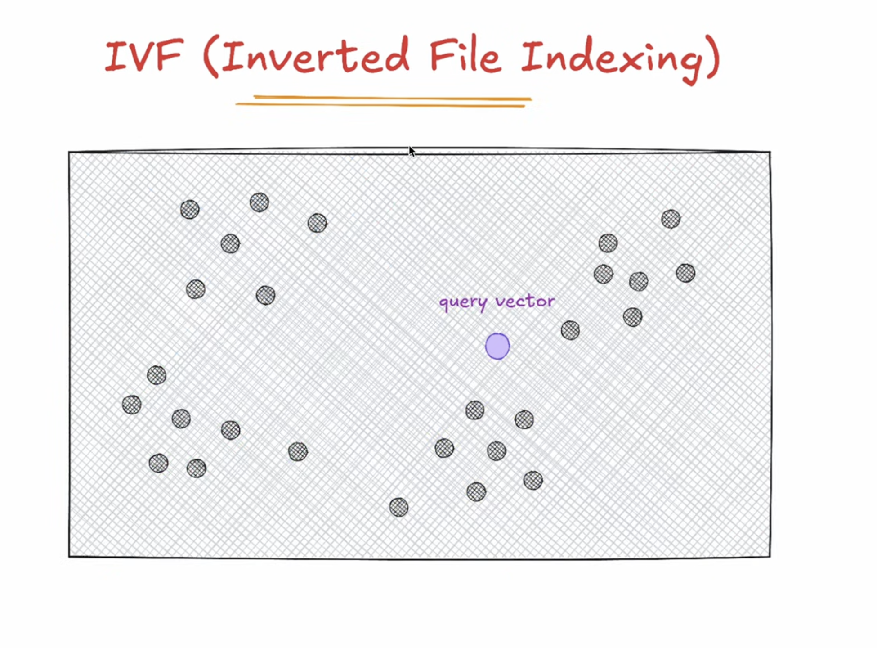

Slide 13
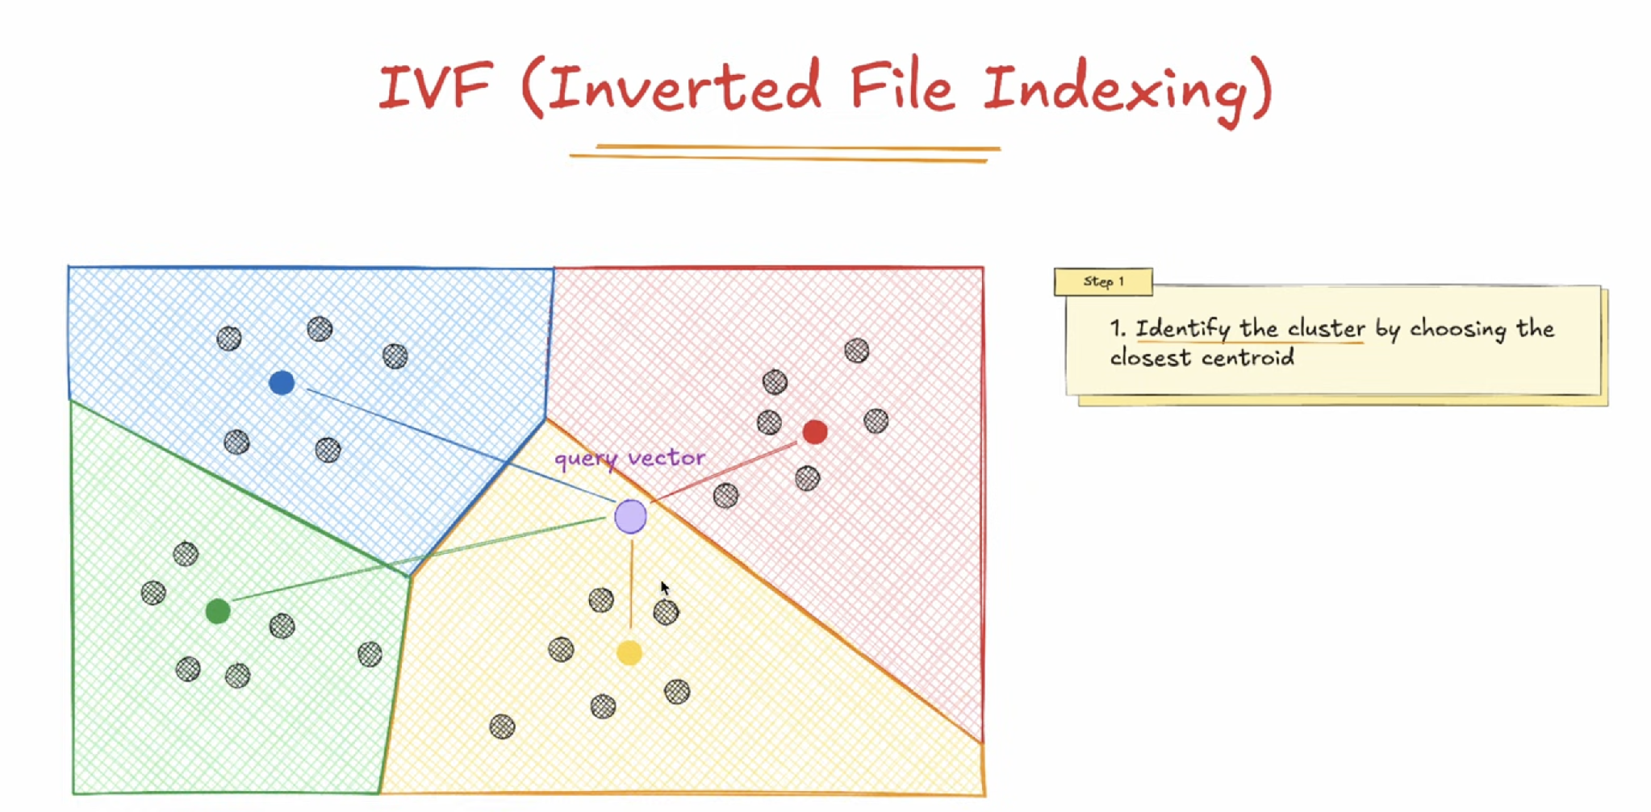
Notes:
Youtube link for slide reference- https://www.youtube.com/watch?v=chz74Mtd1AA

Slide 14
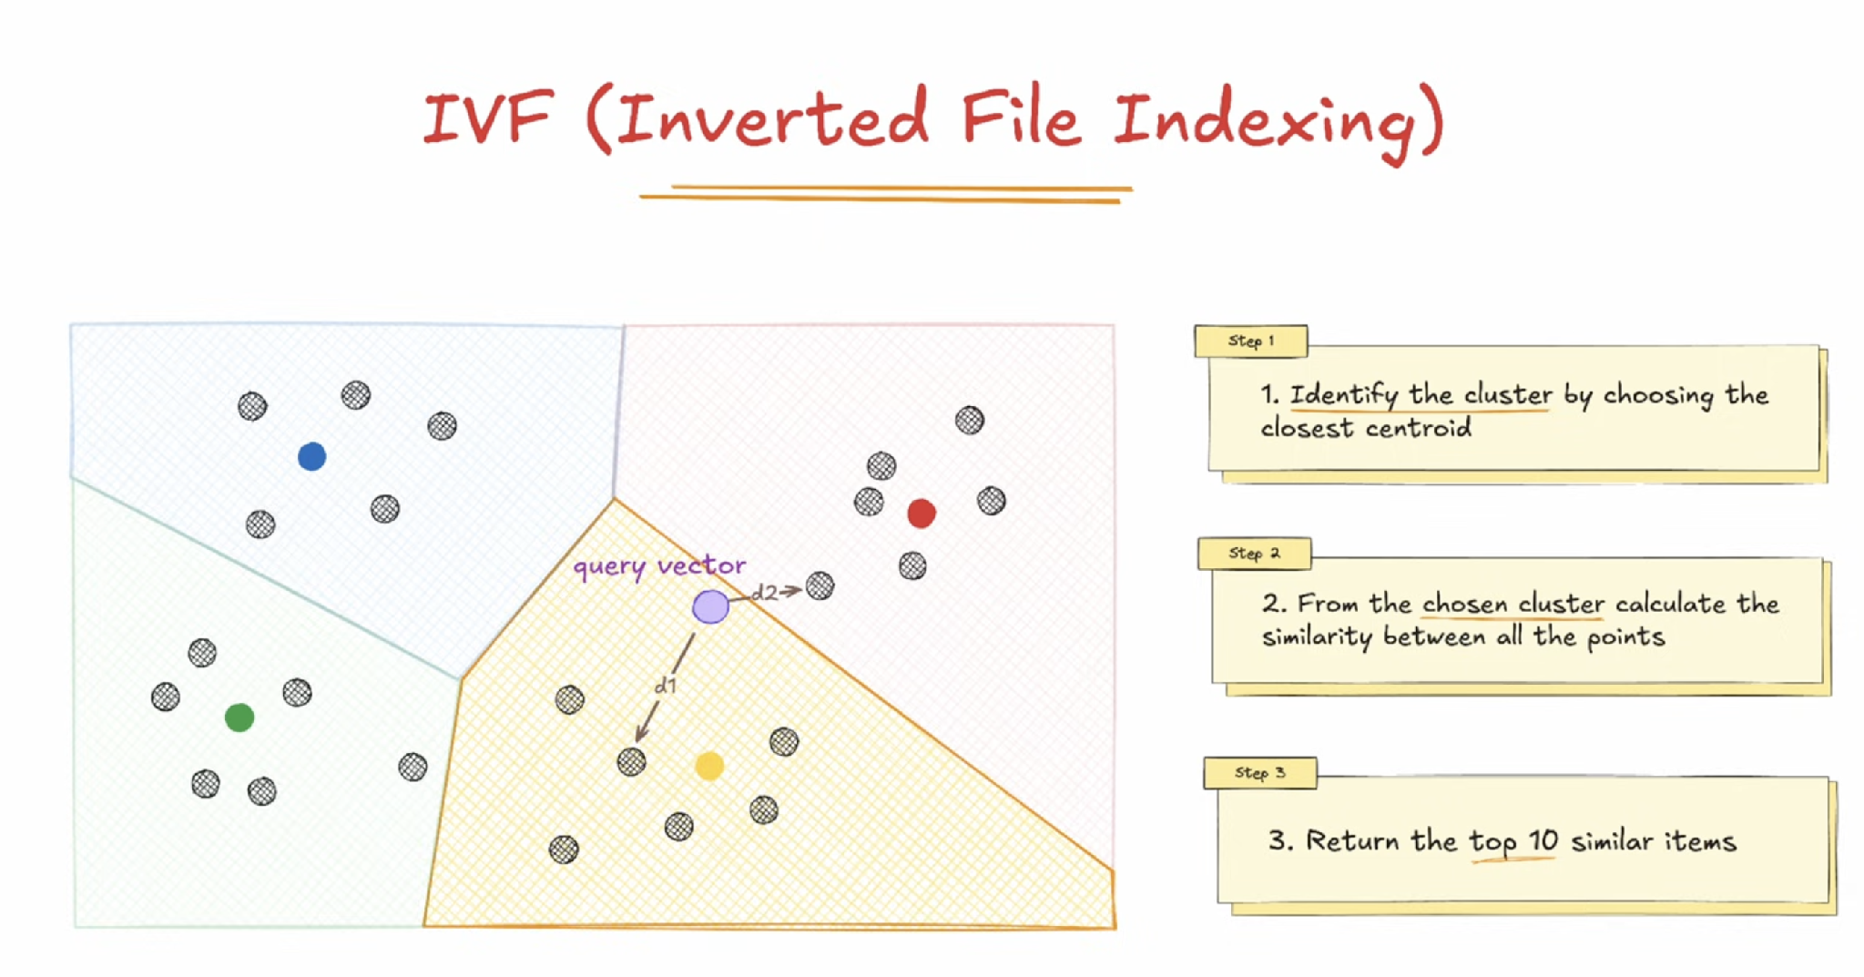

Slide 15
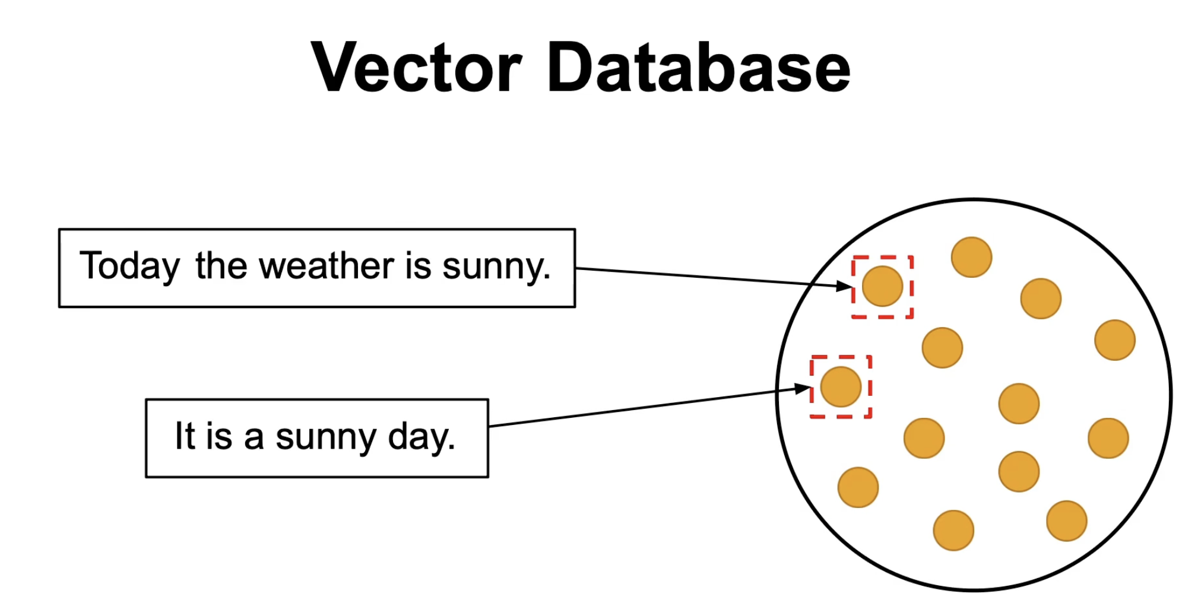
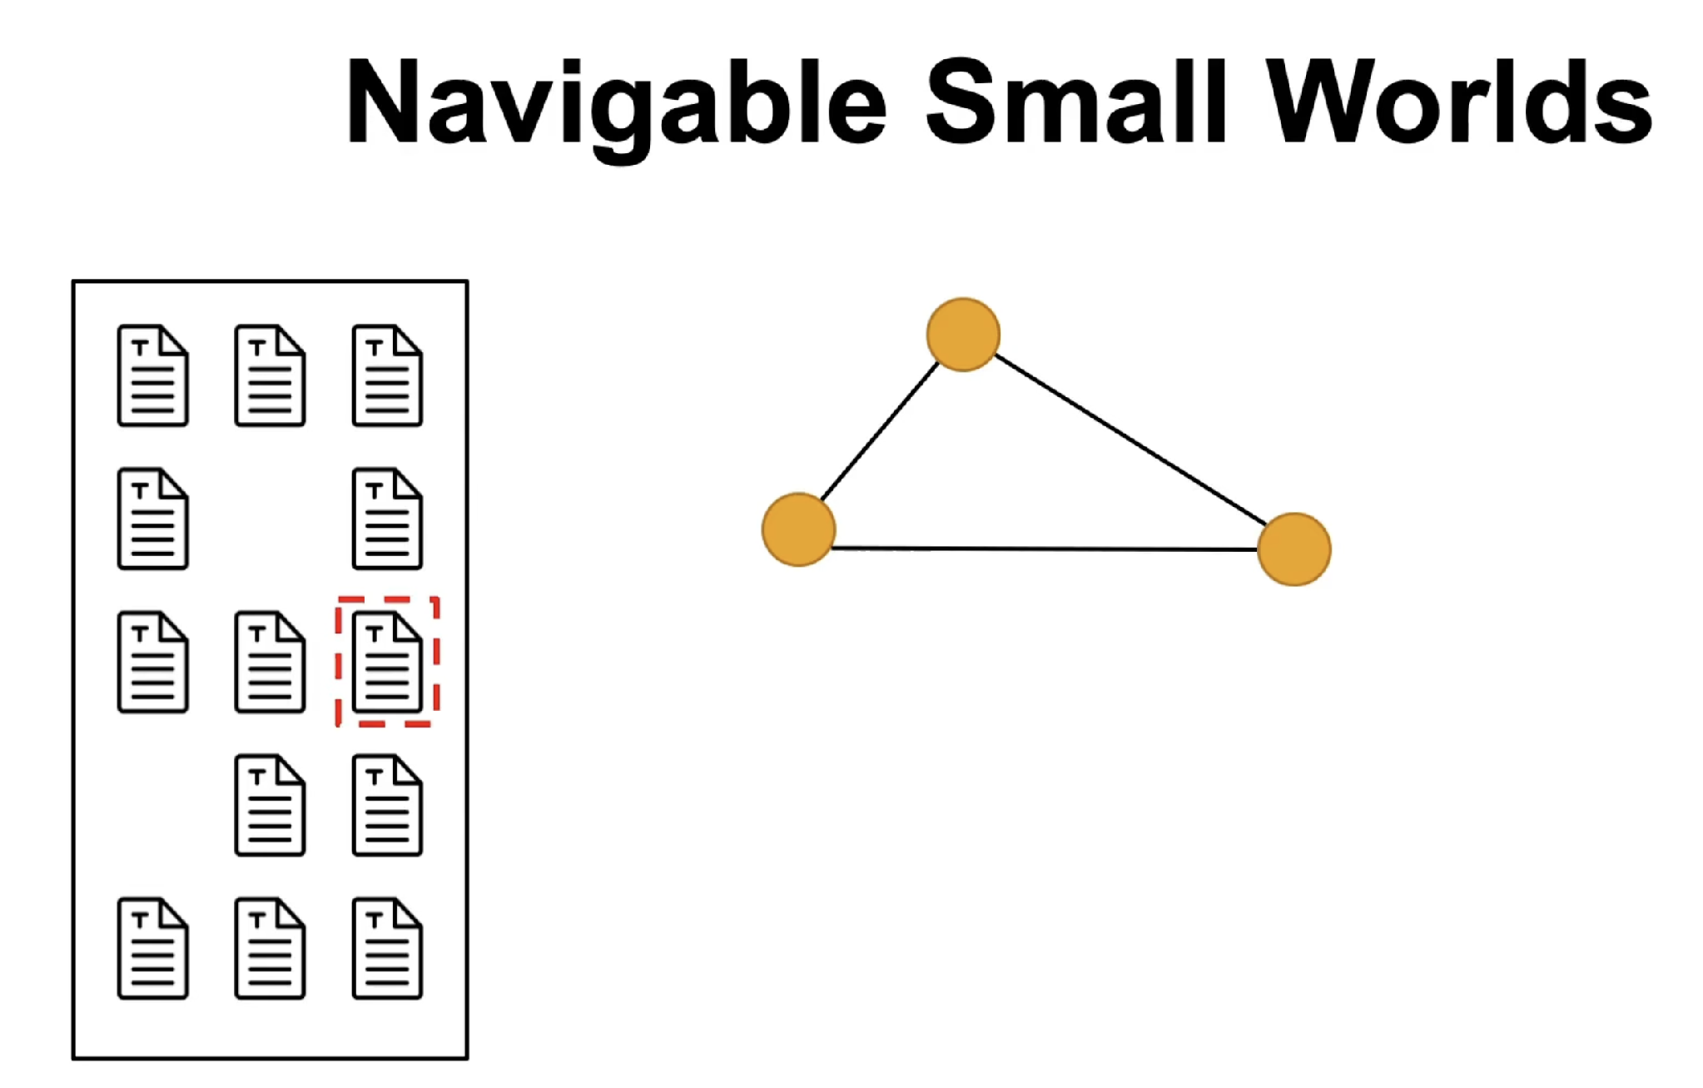
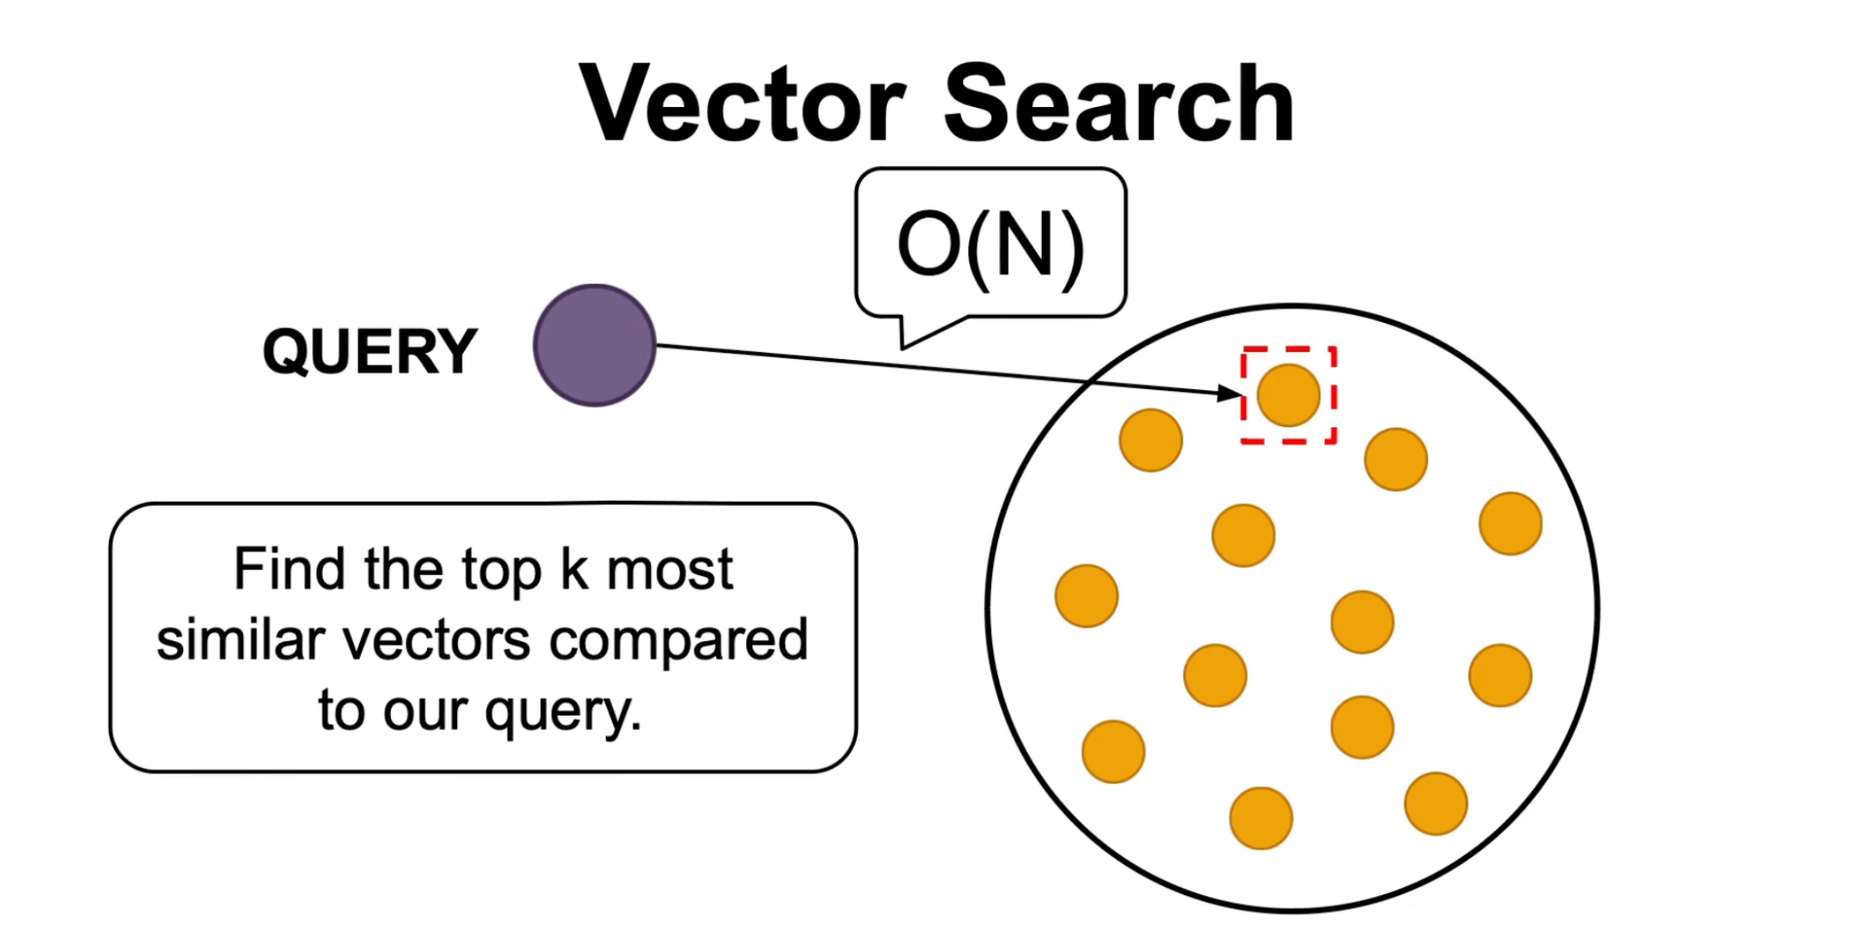
Each node represents a vector.
Find the K nearest neighbors to a new vector.

Slide 16
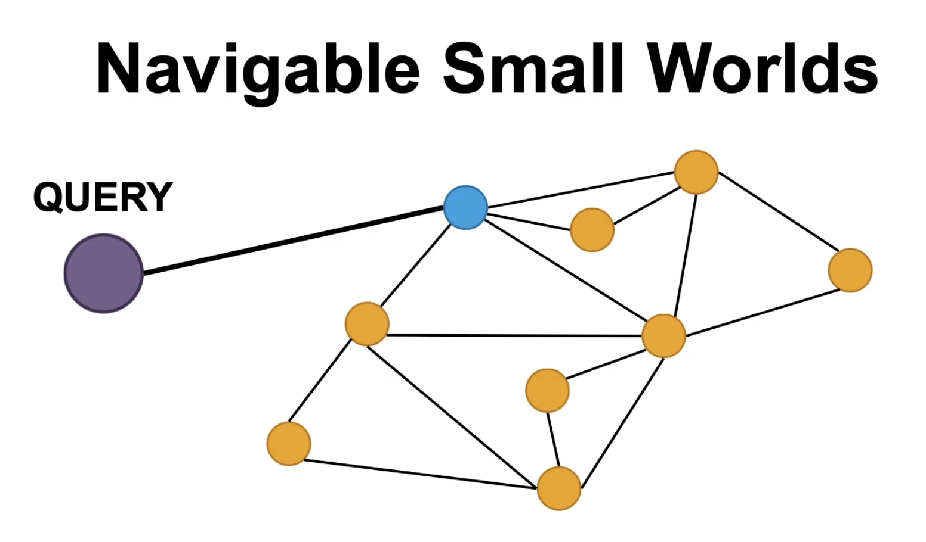
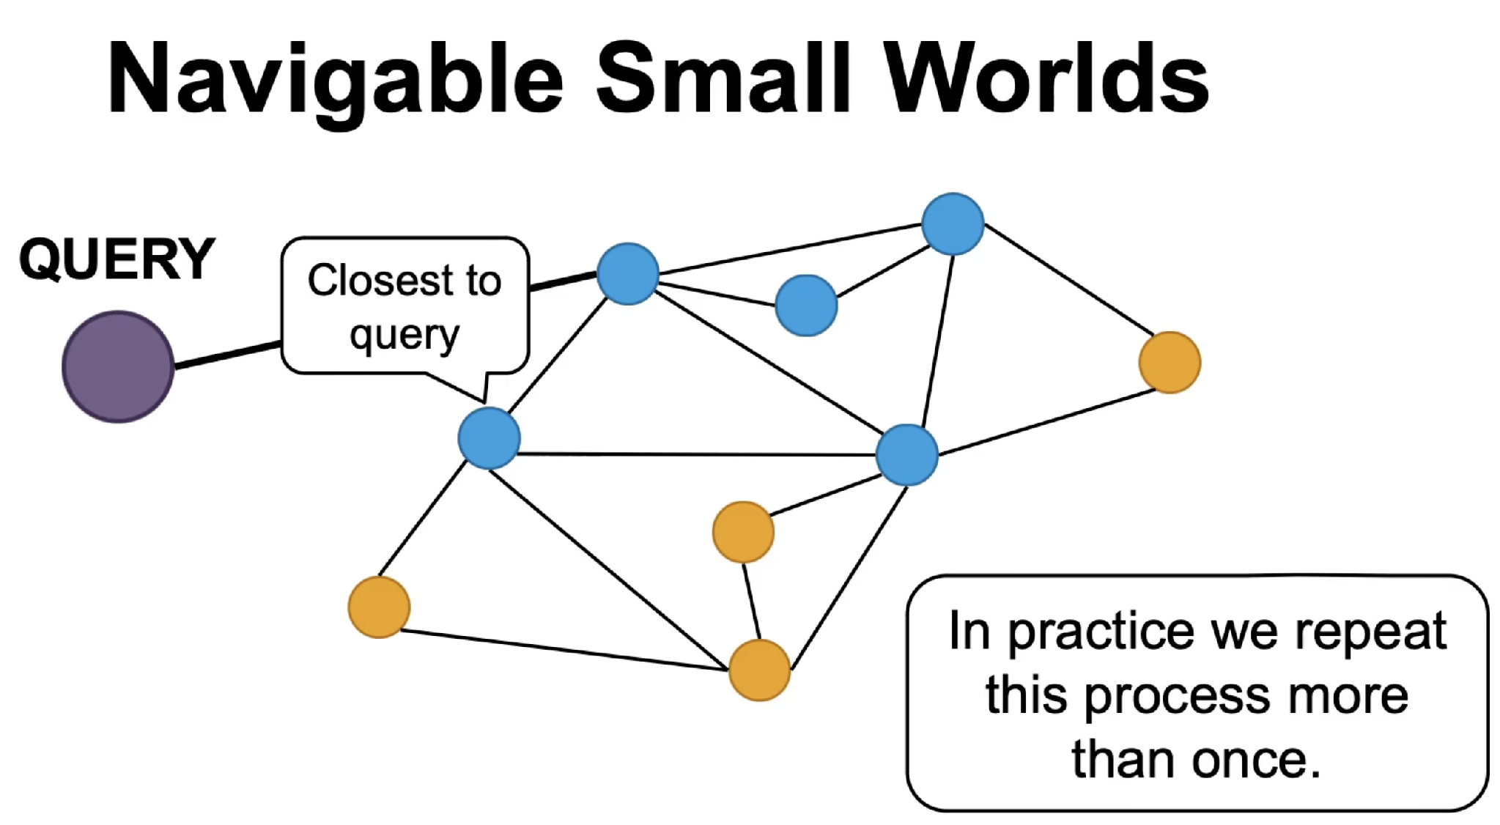
Notes:
Youtube link for slides reference- https://www.youtube.com/watch?v=77QH0Y2PYKg

Slide 17
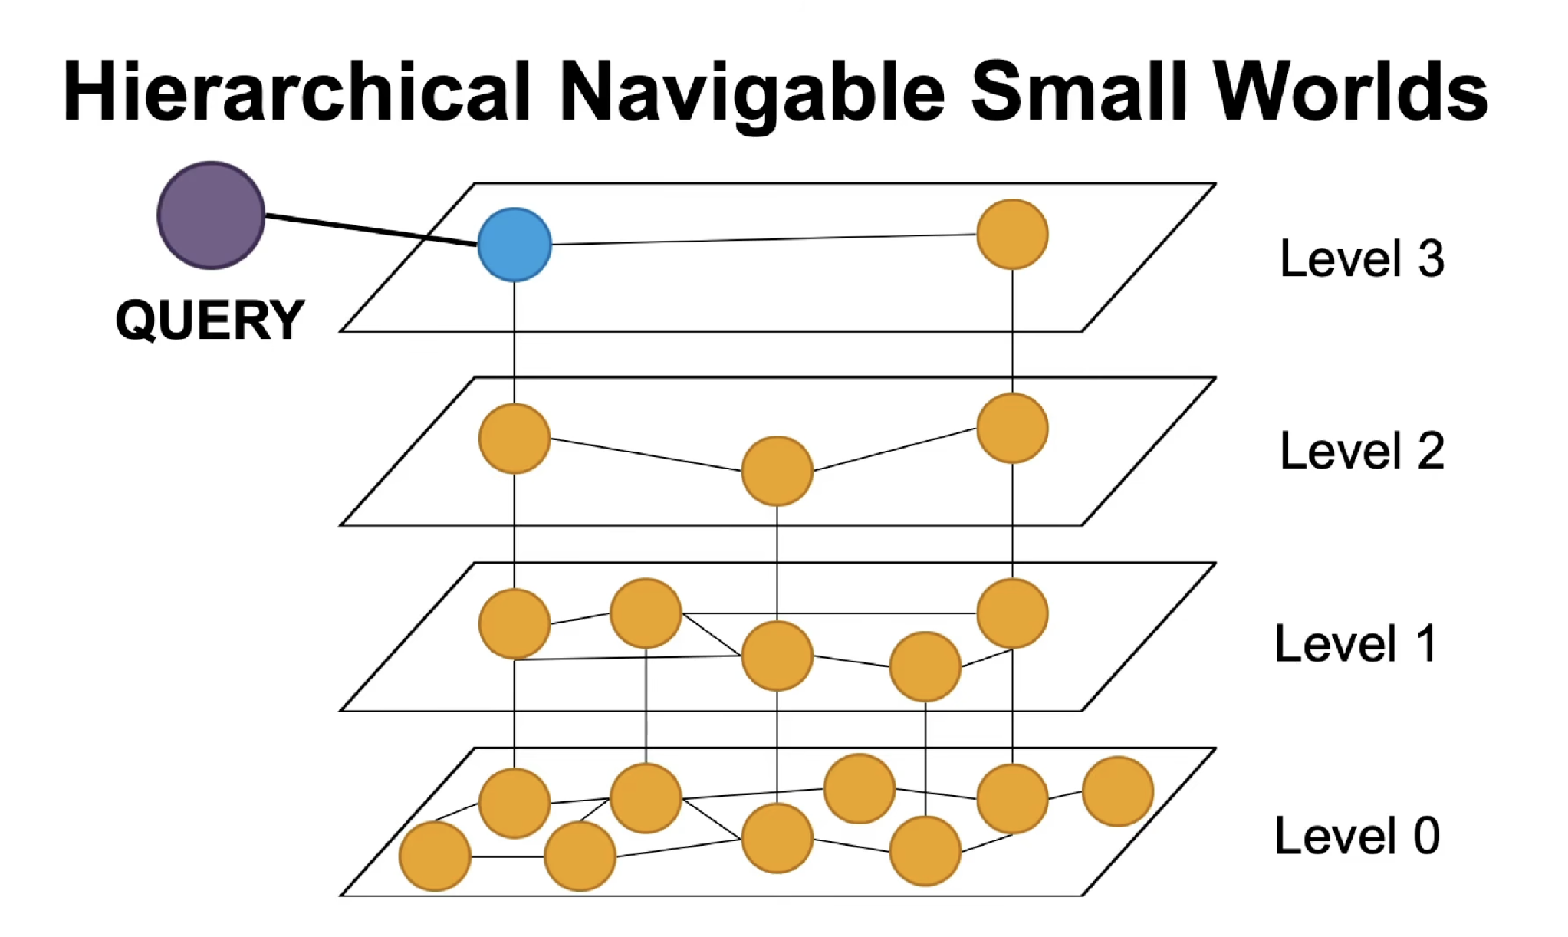

Slide 18
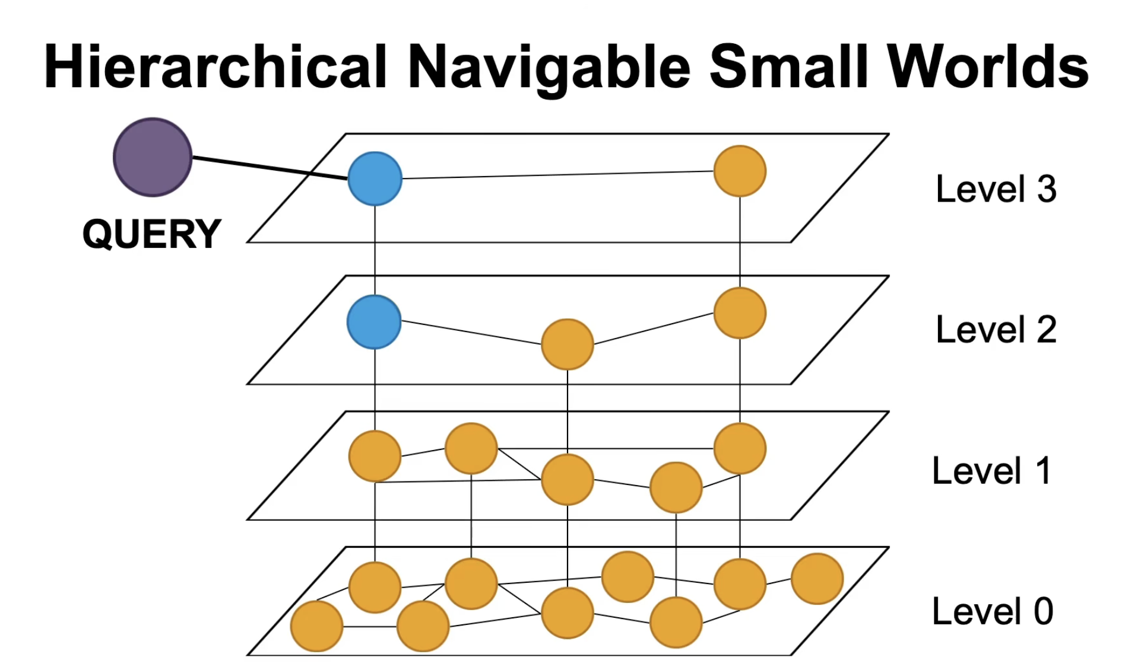
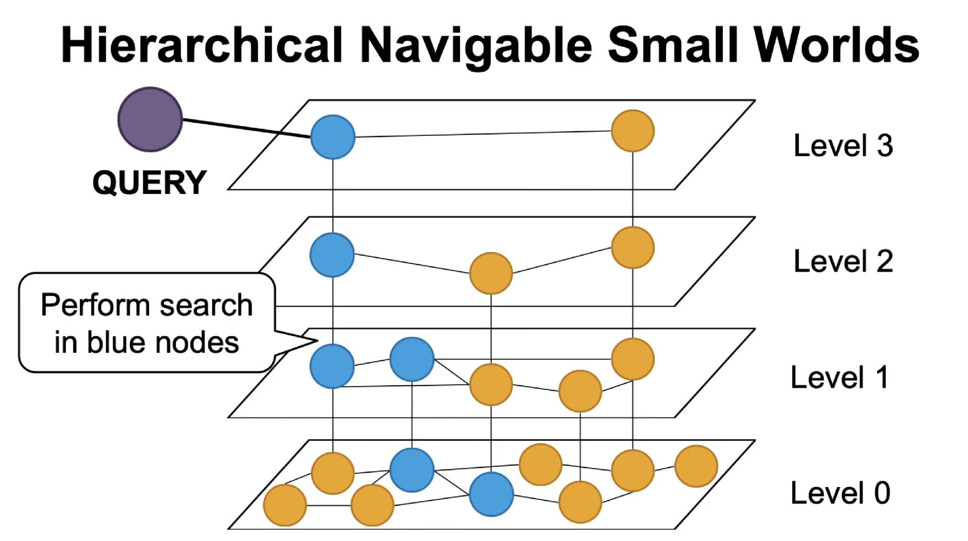

Slide 19
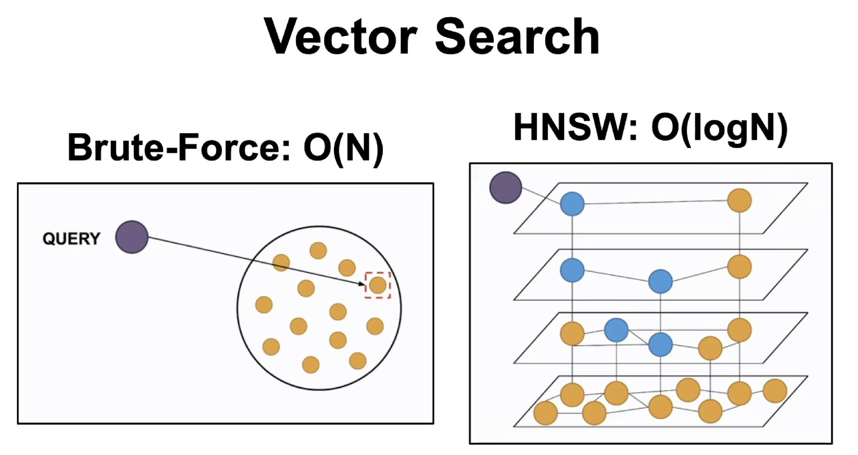
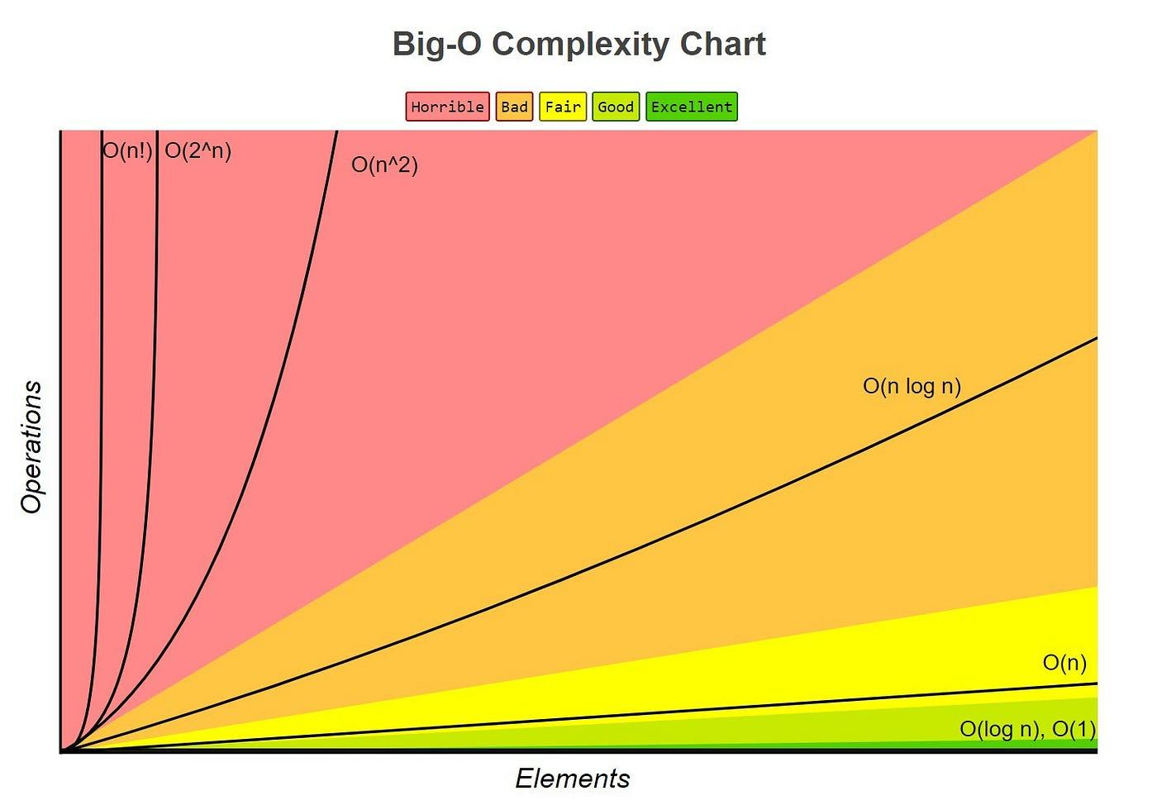
While searching a single layer, HNSW keeps:
a candidate list — nodes it has discovered but not yet explored, ordered by closeness to the query, so it always expands the most promising one next; and
a results list — the best ef nodes found so far. This is the one whose size ef caps.

Slide 20
Three ways to run it
Same API surface, wildly different operational weight.
Milvus Lite
Standalone
Distributed
A Python library. Embedded,
file-backed, zero services.
One container: Milvus plus
etcd plus MinIO.
Full Kubernetes deployment,
components scaled separately.
Use it for
Use it for
Use it for
Prototyping and unit tests
on a laptop.
Single-node deployments
and small collections.
The NRP instance we connect
to from UMN servers.
Practical note: client code is portable across all three. Develop against Lite, deploy against the cluster — the failure modes differ, but the calls do not.
Notes:
Worth naming the firewall reality here: reaching NRP on 50051 from UMN is the first thing that will bite anyone trying to follow along.

Slide 21
Hybrid query = vector similarity + scalar filtering
1
Filtering is not a post-step
client.search(
collection_name="ztf_alerts",
data=[query_embedding],
limit=50,
filter='jd > 2460800 and magpsf < 18.5'
' and drb > 0.9',
output_fields=["objectId", "jd"],
search_params={"metric_type": "COSINE",
"params": {"ef": 128}},
)
Milvus applies the predicate during graph or cluster traversal, so you still get 50 results — not 50 minus whatever failed the filter.
2
Selectivity changes everything
A filter matching 0.1% of the corpus can make ANN slower than brute force over the filtered subset. Milvus decides; you should know it is deciding.
3
Index your scalars too
Filter fields want their own indexes. This is the single most common performance surprise.
As the search walks the graph and considers each candidate node, it checks that candidate against your scalar filters,
and only keeps it as a valid neighbor if it passes both tests.
It traverses across failing nodes to keep moving, but only collects the passing ones into your final neighbor list.

Slide 22
Two things that surprise everyone
Neither is a bug. Both will cost someone an afternoon.
1
You must load before you query
2
Inserts are not instantly visible
A collection sits in object storage until you explicitly load it into the query nodes’ memory. Search a collection that isn’t loaded and you get an error, not slow results.
-Inserts/writes land in the log immediately, safe but not searchable
-Fresh data becomes visible once it flows into an in-memory growing segment.
-growing segments are typically searched more brute-force since the efficient index is built at sealing time
-When a growing segment reaches a certain size, or sometimes a time limit, that's when it gets sealed, flushed to storage, and indexed.
client.load_collection("ztf_alerts")
Loading is also how memory gets consumed — see the cost slide.
Notes:
graph-walking, the distance calculations, the neighbor-finding, happens right there

Slide 23
Where Milvus sits in boom
Two paths. Milvus is an index over our data, never the source of truth.
WRITE PATH
Kafka
alert stream
boom
processing
Embedding
model
Milvus
insert
READ PATH
babamul-web
query
Milvus
search
IDs + scores
returned
MongoDB
Hydrate (photometry, cutouts, metadata)
What Milvus stores
Why that matters
The embedding, the object ID, and the handful of scalars we filter on.
If the collection is lost or the model changes, we rebuild it from Mongo and Kafka. Losing the index is an inconvenience, not a data loss.
Notes:
This is the slide the team will actually argue about. Leave room for it.

Slide 24
“Why not use another vector DB?”
Data ingestion volume- data nodes
Similarity search requests- query nodes
FAISS, in-process
A library, not a service. Fastest path to an answer.
You may not need a database at all if the index fits in one process.
pgvector
Vectors inside Postgres. Joins and transactions for free.
Excellent below ~10M vectors. Scaling and index rebuilds get painful above that.
Qdrant / Weaviate
Purpose-built, simpler to operate than Milvus.
Strong choices. Smaller ecosystem, less proven at 100M+ scale.
Elasticsearch kNN
Vector search bolted onto a text engine.
Compelling if you already run ES for something else. We do not.
Milvus
Built for this scale from the start.
Chosen because Rubin-era volumes are the design target, and NRP already hosts it.
If we were storing 5 million vectors, pgvector would be the right answer and this talk would be four slides long.
Notes:
Data ingestion volume- data nodes
Similarity search requests- query nodes

Slide 25
How would we know it works?
Two different questions, and only one of them is about the database.
A
Is the index faithful?
B
Are the neighbours meaningful?
An engineering question with a mechanical answer. Take a sample of queries, brute-force the true top-k with a FLAT index, and measure overlap.
A science question, and much harder. Perfect recall over a bad embedding gives you a perfectly faithful list of irrelevant objects.
recall@k · target ≥ 0.95
Do neighbours share spectroscopic class labels?
Do known variables retrieve their own kind?
Would an astronomer agree with the top 10?
Tune ef or nprobe until you hit it. Done.
Build the evaluation set before the pipeline. Retrofitting ground truth after launch never happens.

Slide 26
The bill nobody quotes
Vector search is a memory problem wearing a database costume.
205 GB
+ 30–60%
~4× less
Raw float32 memory for 100M × 512-d vectors, before any index overhead.
What an HNSW graph adds on top of the vectors themselves.
What scalar quantisation to int8 buys back, at a few points of recall.
1
Index build is not free
Building HNSW over 100M vectors is hours of CPU, and it happens again every time the embedding model changes.
2
Reindexing is a migration
New model means new vectors means a full rebuild. Plan for a dual-collection cutover, not an in-place update.
3
Deletes are tombstones
Removed entities linger in sealed segments until compaction. Space is reclaimed later, not immediately.
Notes:
The 205 GB figure is just 100e6 * 512 * 4 bytes — show the arithmetic, it lands better than the number alone.

Slide 27
What to take away
Five sentences, if the rest evaporates.
1
The database searches; the model means.
Embedding quality bounds everything downstream of it.
2
Results are approximate by design.
Recall is a dial you set, and one you can always measure.
3
Real queries are filtered queries.
Schema and scalar indexes deserve as much thought as the vector field.
4
Milvus is an index, not a store of record.
Mongo stays the source of truth; the collection is rebuildable.
5
Memory is the real constraint.
Budget RAM and rebuild time before committing to dimensionality.
Questions — and bring the filters you’d want to run.
Notes:
Close by pointing back to slide 11 — the filter list from the room is the input to the schema design.

